Slide 1
BIRD STRIKE 2000-2011

Slide 2
A bird strike is strictly defined as a collision between a bird and an aircraft which is in flight or on a take-off or landing roll. Bird Strike is common and can be a significant threat to aircraft safety. Bird strikes may occur during any phase of flight, but are most likely during the take-off, initial climb, approach and landing phases due to the greater numbers of birds in flight at lower levels.
INTRODUCTION

Slide 3
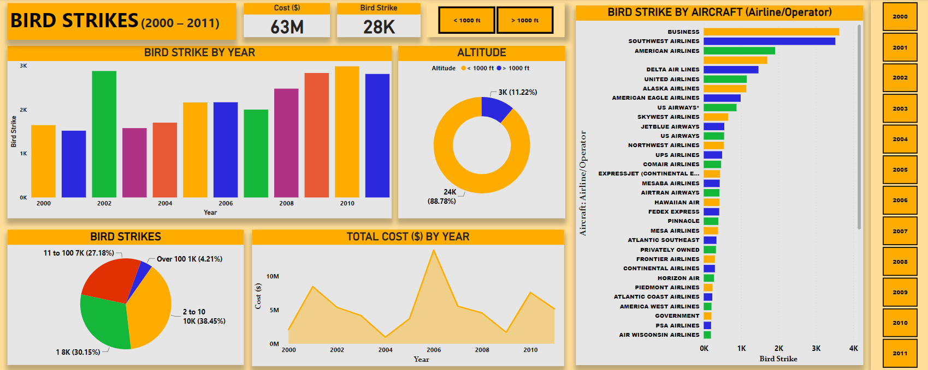
DASHBOARD - Page 1

Slide 4
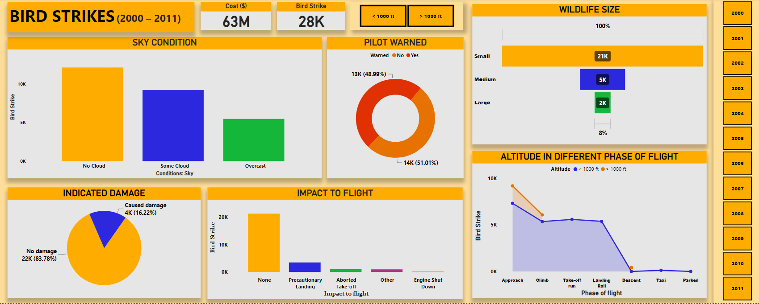
DASHBOARD - Page 2

Slide 5
Business airlines has maximum bird strike. Altitude <1000 has highest number of bird strike about 88.78% Phase of flight- approach at maximum altitude with maximum bird strike followed by climb, take-off, landing, descent, taxi & parked. About 52% pilots warned of birds & wildlife. During no cloud sky condition, maximum number of birds & wildlife were struck. Size of birds & wildlife plays a vital role to signify factors of causing damage. small size has highest struck followed by medium and then large. And more…
KEY INSIGHTS

